Slide 1
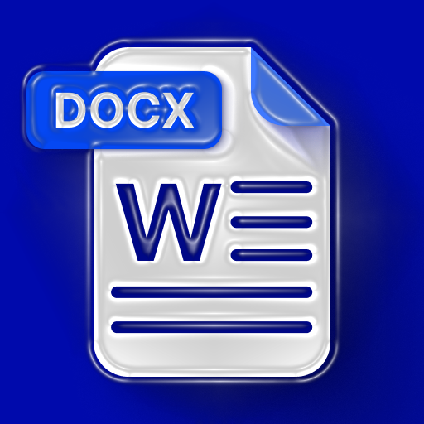
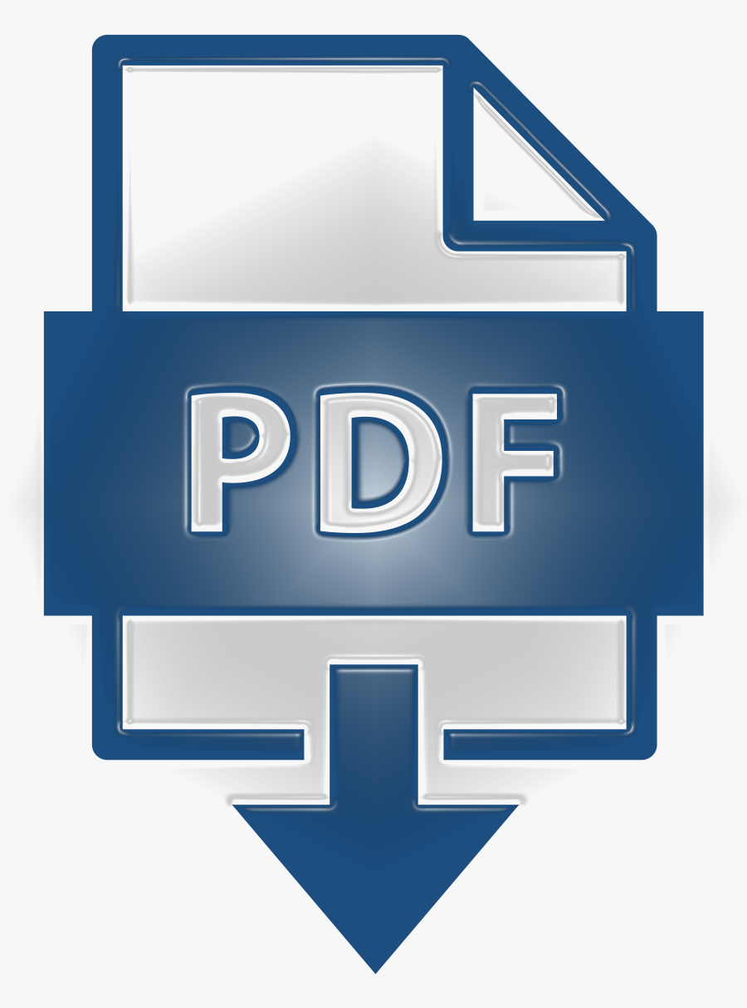
File Conversion: DOCX to PDF and PDF to DOCX

Slide 2
Code Overview
This Python script provides classes for converting documents between different formats:
- Docx2PdfConverter: Converts DOCX to PDF
- Pdf2DocxConverter: Converts PDF to DOCX
Dependencies: Requires the docx2pdf and pdf2docx libraries. Install them using:
pip install docx2pdf pdf2docx

Slide 3
Convert DOCX to PDF
Example usage of the document conversion script:
- Convert DOCX to PDF
- Input: Specify the path to the input DOCX file
- Output: Specify the desired path for the output PDF file
- Example:
docx_path = "input_file.docx"
pdf_path = "output_file.pdf"
converter = Docx2PdfConverter(docx_path, pdf_path)
converter.convert_docx_to_pdf()

Slide 4
Convert PDF to DOCX
Example usage of the document conversion script:
- Convert PDF to DOCX
- Input: Specify the path to the input PDF file
- Output: Specify the desired path for the output DOCX file
- Example:
pdf_path = "input_file.pdf"
docx_path = "output_file.docx"
converter = Pdf2DocxConverter(pdf_path, docx_path)
converter.convert_pdf_to_docx

